Slide 1
Live 360! Events
Conference Review
Follow along at:
http://bit.ly/15u1FQ8 or http://html5demo1.azurewebsites.net/
Presented by Darek Tomyn
Darek.Tomyn@solvera.ca
Notes:
Was allowed the opportunity of attending a conference in December called Live360. This presentation had its genesis from attending this.
You may access all of the material for the event by going to the following link
http://www.redmondevents.com/virtual/login.aspx?ReturnUrl=%2fvirtual%2fvslive%2f2012%2flive360%2fDefault.aspx
Username: LIVE!360
Password: Orlando4in1

Slide 2
Quick Summary
Historically, Visual Studio Live annual event in Orlando
1st time “combined 4 events into 1”:
Visual Studio
SharePoint
SQL Server
Cloud & Virtualization
Often there were 16 sessions happening at once!
Typical day was sessions running from 8 am to 5:30 pm
First and last days were “workshops”
Microsoft technologies but not hosted by Microsoft

Slide 3
What my objectives were…
HTML 5… learn more including the “state” of it and how to get browsers to work with it
Azure… what “state” is it in? How to use, etc
Mobile… Windows phone… but knew coming in that did not seem to be a lot regarding it
Any trends that I did not previously know about

Slide 4
What I learnt – A Visual
Big Data
Azure
Other…
HTML 5
Websites
<audio>
<video>
CSS3
SharePoint
<canvas>
svg
Modernizr
<form> enhancements
Semantic tags
OAuth
SignalR
SQL Server 2012 New Features
jQuery mobile

Slide 5
What I learnt – HTML 5
Sessions I attended:
CVM3 – Workshop HTML5 – Cloud: Reach Everyone, Everywhere
VSW9 – HTML5 Forms
VSW13 – HTML5 Everywhere
Wee bit of history:
HTML (1991), HTML2 (1994), HTML3 (1995), HTML3.2 & 4 (1997), XHTML1 (2000), AJAX (2005), HTML5 (2007)
W3C wanted XHTML 2, browser groups wanted HTML 5… so they created WHATWG¹.
W3C’s XHTML 2 ultimately died on July 2, 2009
WHATWG survived
WHATWG gave W3C permission to publish HTML 5… so really are 2 “specs” out there
Notes:
¹WHATWG is an acronym for the “Web Hypertext Application Technology Working Group” http://www.whatwg.org/

Slide 6
HTML 5 (cont’d)
Apple’s affect:
“The world is moving to HTML 5” – Steve Jobs
iDevices have no support for Flash
Logo / marketing material²
Spec moves through:
1st Published Working Draft -> Working Draft -> Last Call -> Candidate Recommendation -> Recommendation
IE goal is CR and up¹ … as a result, they “score” much lower
WHATWG said “maybe” 2022 for finalization ☹ HOWEVER, there are sections that go through above spec movement / flow
What does “recommendation” really mean? 2 independent browsers must implement spec 100%... That’s it. Again, it’s the browser groups that are creating it and have to agree together
Current main browsers are: IE, Chrome, Firefox, Safari and Opera
Notes:
¹ IE team has http://html5labs.interoperabilitybridges.com/ that tries to do better than this though

Slide 7
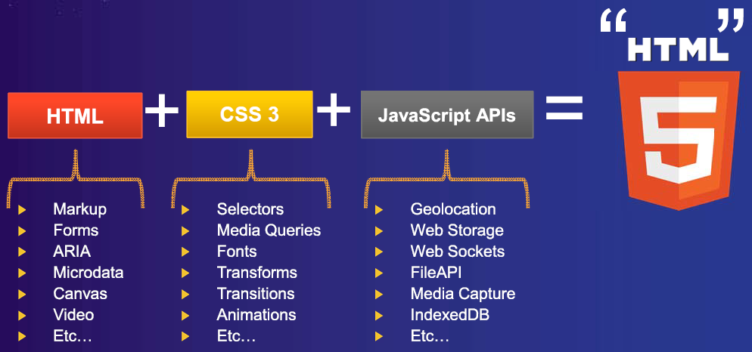
HTML 5 – What is it?
What is it? HTML + CSS3 + JavaScript APIs

Slide 8
HTML 5 – Simplification
The new doctype is simply: <!DOCTYPE HTML>.
The character set is simply declared with: <meta charset="UTF-8">.
The type attribute is no longer required on <style> and <script> tags
Elements that are by nature self-closing now do not need “/”
img
br

Slide 9
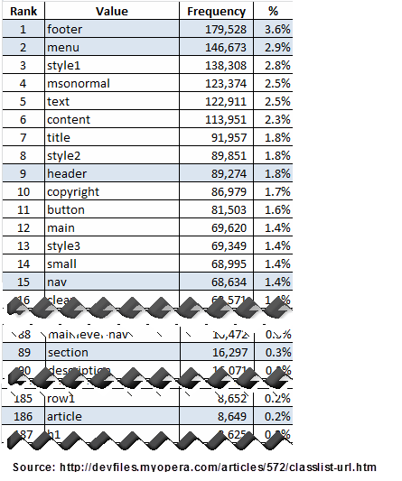
HTML 5 – Semantic Markup / New Tags
Opera did a 2 year study for common id’s used

Slide 10
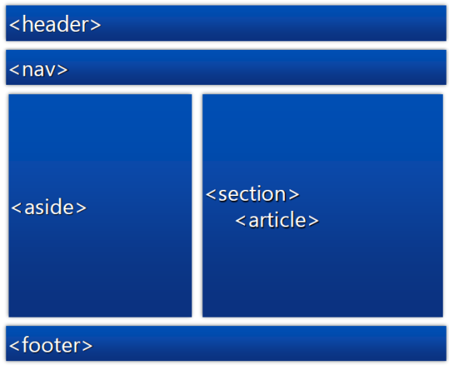
HTML 5 – New Tags

Slide 11
HTML 5 - Browser Support
Before get much further though… how is browser support?
Html5test.com, canIuse.com, and lots of others
Don’t sniff browsers… test for features
WHAT ABOUT IE? One option is Google Chrome Frame for <=8¹
Adoption strategies: lowest common denominator, polyfill enriched
What is a “Polyfill”?²
JavaScript that implants HTML5 functionality in a browser that does not offer native support
Modernizr³
Small JavaScript library that aids backwards compatibility with polyfills for HTML5 & CSS3 features
DEMO 1 – 3
http://html5demo1.azurewebsites.net/Index.html
Notes:
¹ Chrome browser engine in IE 6/7/8/9
chrome=1 - Always active
chrome=IE7 - Active for IE major version 7 or lower
chrome=IE8 - Active for IE major version 8 or lower
² http://remysharp.com/2010/10/08/what-is-a-polyfill/ https://github.com/Modernizr/Modernizr/wiki/HTML5-Cross-browser-Polyfills
³ http://www.modernizr.com http://www.alistapart.com/articles/taking-advantage-of-html5-and-css3-with-modernizr/
http://haz.io/

Slide 12
HTML 5 Form Enhancements
<input type=
Email, url, search, number, date, time, color, etc
New attributes
Placeholder, autofocus
Contenteditable
Remember sites mentioned previously: Html5test.com, canIuse.com
Demo 4
http://html5demo1.azurewebsites.net/Demo04-NewInputTypes.html

Slide 13
HTML 5 MultiMedia Enhancements
New “audio” and “video” tags
Demo 5
http://html5demo1.azurewebsites.net/Demo05-Multimedia.html

Slide 14
Azure
Sessions I attended:
Most made reference to it / used it
What is it?
cloud computing is really doing just-in-time provisioning and scaling of services, software and solutions delivered as a service on a pool of hardware
On demand provisioning
scaling resources... example “tonight I need 10,000 nodes for an hour until batch is done”
abstraction over resources
Demo 6
Create a website using Azure… show other options here
https://manage.windowsazure.com
Link to my github repository
Create new site and download publish settings for deploying in Visual Studio

Slide 15
Mobile
Sessions I attended:
VSW8 – MVC4 and jQuery mobile
VST8 – Windows Phone 8 enhancements (was a waste of time)
Unfortunately not the conference to learn a lot of mobile
Concentration on HTML5 including CSS3 for formatting with mobile in mind
3 good takeaways
JSON for serialized data for smaller payload
Opera mobile emulator
By default, add the below “viewport” to all web pages:
<meta name="viewport" content="width=device-width, user-scalable=no">
Demo 7
Opera mobile emulator
Page with and without meta tag

Slide 16
Trends - SignalR
Sessions I attended:
CVTH05 – Real-Time Communications with SignalR And Windows Azure
“Any sufficiently advanced technology is indistinguishable from magic” – Arthur C. Clarke
An open source series of libraries that provide an abstraction around persistent HTTP connections
Makes real-time HTTP so easy it seems like “magic”
Uses HTML 5 WebSockets if available then does fallbacks
http://www.asp.net/signalr/
Demo 8
Start up demo site on Azure
2 different demos here:
HitCounter
Chat

Slide 17
Other observations
Nuget
Visual Studio add-in to import in external resources easily
Git
Cvs -> svn -> git
Bit.ly
Less and less people using tinyurl.com
“Big data” still in infancy (IMO)

Slide 18
Missing from presentation / not enough time
Azure… just touched on it
CSS 3... For example: media queries
“Big Data”
Modernizr… only mentioned it, didn’t really show it
Other HTML 5 features
More MultiMedia capabilities (i.e. Video and Audio)
Ex. Closed captioning
Storage
Offline
Geolocation
Canvas
SVG
etc

Slide 19
Overall Opinion of Conference
While there…
Wanted more… more HTML 5, more mobile
Logistics… felt could have been better
Accomodations… beautiful, close to Universal Studios
Not a “swag” conference
Looking back…
I am surprised at how much I did actually learn… or at least spark an interest in
Would recommend in the future
Ability to jump from session to session because of so many running concurrently was a big benefit

